Slide 1
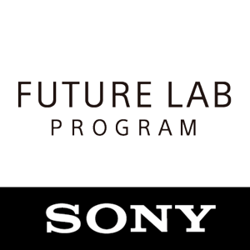
Concept Prototype N - 2 minute intro San Francisco February 10th

Slide 2
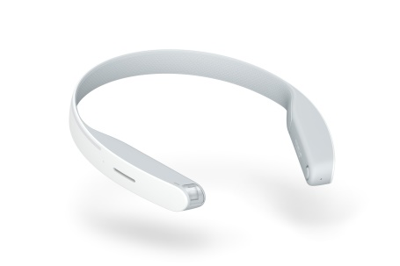
Concept Prototype N

Slide 3
Concept Prototype N – Quick introduction
Concept Prototype N is the first project from the Sony Future Lab program
N is an experience featuring a hands-free user interface that creates a new way of experiencing audio such as music and sound, allowing the user to receive audio information without having to insert anything into his or her ear.
In our workshop we will give you a full overview of concept prototype N, talk about the new R&D program Future lab, as well as showing you what you can do with the device
We will also be handing out a quick start guide that should help you get your first segment up and running in 5 minutes as well as providing you with a jump drive containing everything you need to develop for Concept N.
We also have some great prizes including 8 Playstation VR bundles and free entry in to our Future Lab program. Total prize value is $7,200
Notes:
Concept N Promotional Video

